Slide 1
Amdocs – Data Analyst (Entry Level) Assignment
Shrikant Popat Khade

Slide 2
Project Overview & Deliverables
Project Introduction The objective of this project was to transform raw financial data into meaningful business insights using data analytics, interactive dashboards, and an AI-powered conversational assistant. Using the German Credit Risk Dataset, the solution helps business stakeholders understand customer behavior, analyze financial exposure, and make data-driven decisions through visual analytics and natural language interactions. ALL DASHBOARD AND THE REQUIREMENTS ARE IN THE GITHUB LINK CONTAINS DASHBOARDS AND EXECUTIVE SUMMARY GitHub Repository: https://github.com/khadeshri19/Amdocs_Assignment Live Application (Vercel): https://chat-bot-amdocsassignment.vercel.app/

Slide 3
PHASE 1 : DATASET SELECTION
For this project, the German Credit Risk Dataset was selected to analyze customer credit behavior and identify potential financial risk indicators. The dataset contains information for 1,000 customers, including demographic details, financial attributes, loan characteristics, and borrowing behavior.
Key features available in the dataset include Age, Sex, Housing Status, Credit Amount, Loan Duration, Savings Accounts, Checking Accounts, and Loan Purpose. These attributes provide valuable insights into customer profiles and lending patterns.
The dataset was chosen because it closely represents real-world financial and credit assessment scenarios. It enables the analysis of customer segments, loan trends, financial exposure, and risk-related patterns that are relevant to both financial services and telecom organizations.
The dataset serves as the foundation for exploratory data analysis, dashboard development, and the Smart Financial Data Assistant designed in this project.

Slide 4
PHASE 2 Dataset Overview
The German Credit Risk Dataset contains information on 1,000 customers and was used to analyze customer borrowing behavior and financial exposure. The dataset includes important attributes such as Age, Housing Status, Credit Amount, Loan Duration, Savings Accounts, Checking Accounts, and Loan Purpose.
The dataset was selected because it represents a real-world credit assessment scenario and helps identify customer trends, financial patterns, and potential risk factors. It serves as the foundation for the dashboard development, business analysis, and the Smart Financial Data Assistant created in this project.
Dataset Characteristics
Total Records: 1,000
Data Type: Structured Tabular Data
Domain: Financial Services / Credit Risk Analysis
Analysis Type: Descriptive Analytics and Business Intelligence
Tools Used: Python (Pandas, Seaborn), Power BI, HTML/CSS/JavaScript
Objective: Understand customer behavior, identify financial exposure patterns, and develop a Smart Financial Data Assistant

Slide 5
Exploratory Data Analysis (EDA)
Exploratory Data Analysis was conducted to understand customer demographics, borrowing behavior, and financial exposure patterns. The analysis focused on age distribution, housing status, loan purpose, credit amount, loan duration, and the relationship between key financial variables. Various visualizations were used to identify trends, customer segments, and potential risk indicators.
Key Findings
Customers with free housing tend to have higher average credit amounts and longer loan durations compared to other housing categories.
Car and Radio/TV loans represent the largest share of loan applications in the dataset.
Most customers belong to the 26–50 age group, making it the dominant customer segment.
Credit amount and loan duration show a positive relationship, indicating that larger loans generally require longer repayment periods.
Missing values were identified in savings and checking account information, highlighting opportunities for improving data quality.

Slide 6
Dashboard Development
An interactive Power BI dashboard was developed to present the analysis in a clear and business-friendly manner. The dashboard enables stakeholders to explore customer behavior, financial exposure, and lending patterns through interactive visualizations and filters.
Executive Overview
Provides a high-level summary of customer demographics, loan purposes, housing profiles, and financial characteristics.
Risk Analysis
Highlights key exposure factors by analyzing credit amount, loan duration, housing categories, and customer segments.
Smart Financial Assistant
Provides a conversational interface that allows users to ask business questions in natural language and receive structured, data-driven responses.

Slide 7
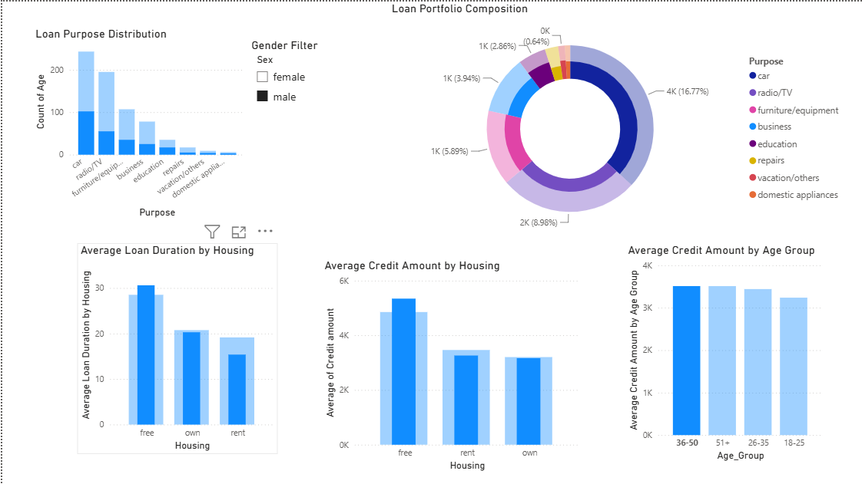
EXECUTIVE OVERVIEW

Slide 8
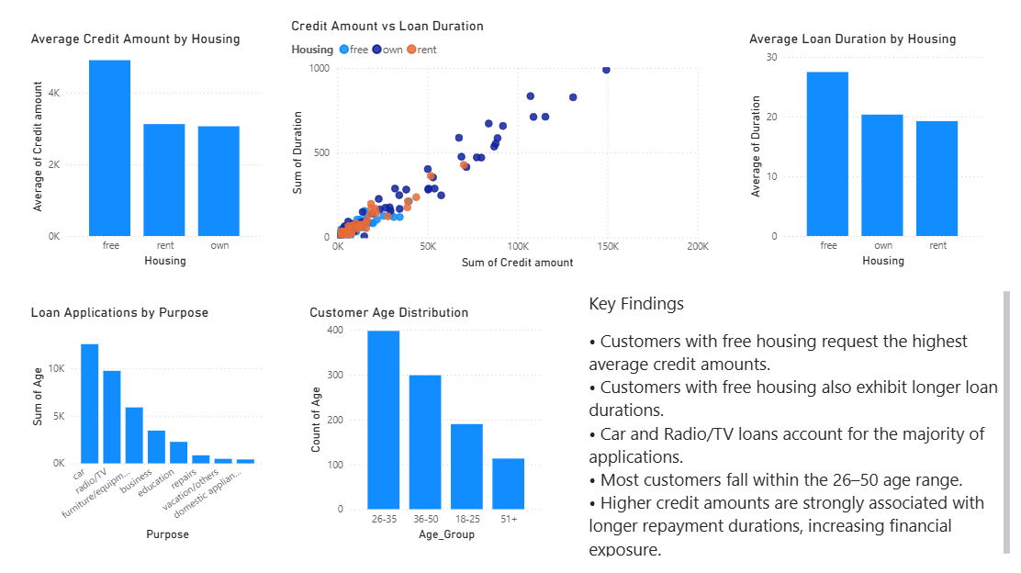
RISK ANALYSIS

Slide 9
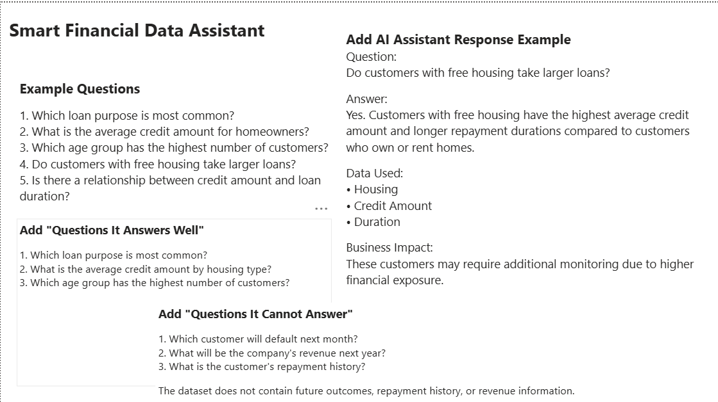

Slide 10
Smart Financial Assistant
A Smart Financial Data Assistant prototype was developed to help users interact with the dataset using natural language queries. The assistant supports summary, aggregation, filtering, and analytical questions while providing clear explanations and business insights.
Example Questions
Which loan purpose is most common?
What is the average credit amount by housing type?
Which age group contains the most customers?
Do larger loans generally have longer repayment periods?
Example Response
Question: Which housing category has the highest financial exposure?
Answer: Customers with free housing exhibit higher average credit amounts and longer repayment durations compared to other housing categories.
Data Used: Housing, Credit Amount, Duration
Business Impact: This segment may require additional monitoring due to higher financial exposure.

Slide 11
Smart Financial Assistant Approach
A Smart Financial Data Assistant was developed to help users explore the dataset using simple English questions. The assistant supports summary, aggregation, filtering, and analytical queries while providing structured responses, business context, and explanations of the data used to generate insights.
Actionable Recommendations
Closely monitor customers requesting high-value loans with longer repayment durations.
Improve data collection by including additional customer information such as income, repayment history, and credit performance.
Regularly review high-volume loan categories to manage portfolio concentration and financial exposure.
Use interactive dashboards and AI-assisted analytics to support faster and more informed business decisions.

Slide 12
Enterprise Product Vision
This solution can be expanded into an enterprise-grade platform by integrating live financial data, predictive risk models, and AI-powered analytics. Future enhancements could include real-time monitoring, automated risk alerts, and conversational business intelligence capabilities for decision-makers.

